Slide 1


Windows App 만들기
C#-Next
천해철 guruchun@gmail.com

Slide 2
Next Windows APP on .NET
Avalonia
(OSS)
UNO
(Microsoft)
Cross-Platform
Cross-Platform
WinForm
WPF
UWP
WinUI 3
Cross-Platform
Mobile APP
Multi-Platform
Xamarin
MAUI
(Microsoft, OSS)
WinForm
/MONO

Slide 3
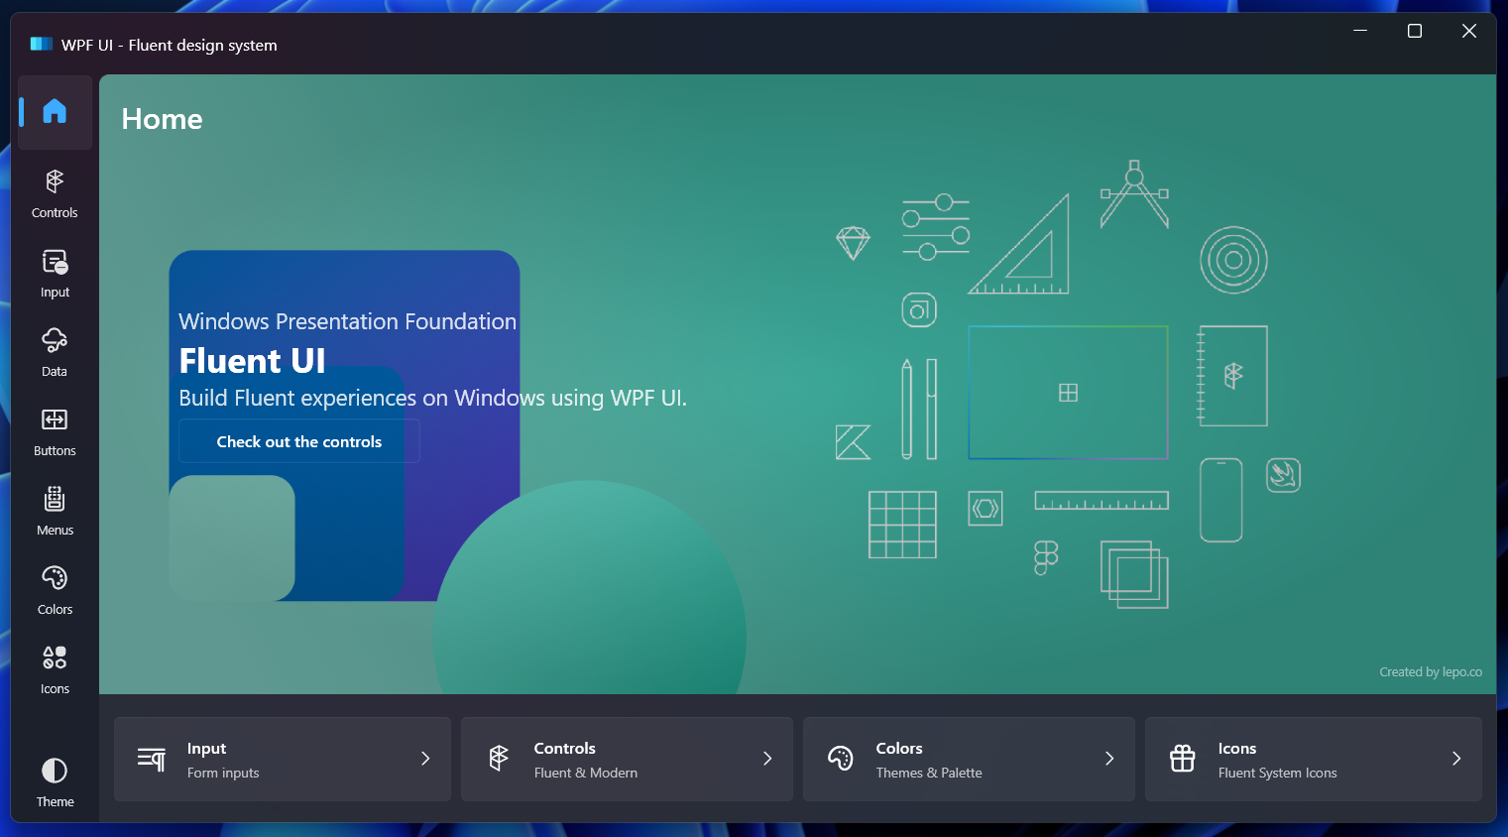
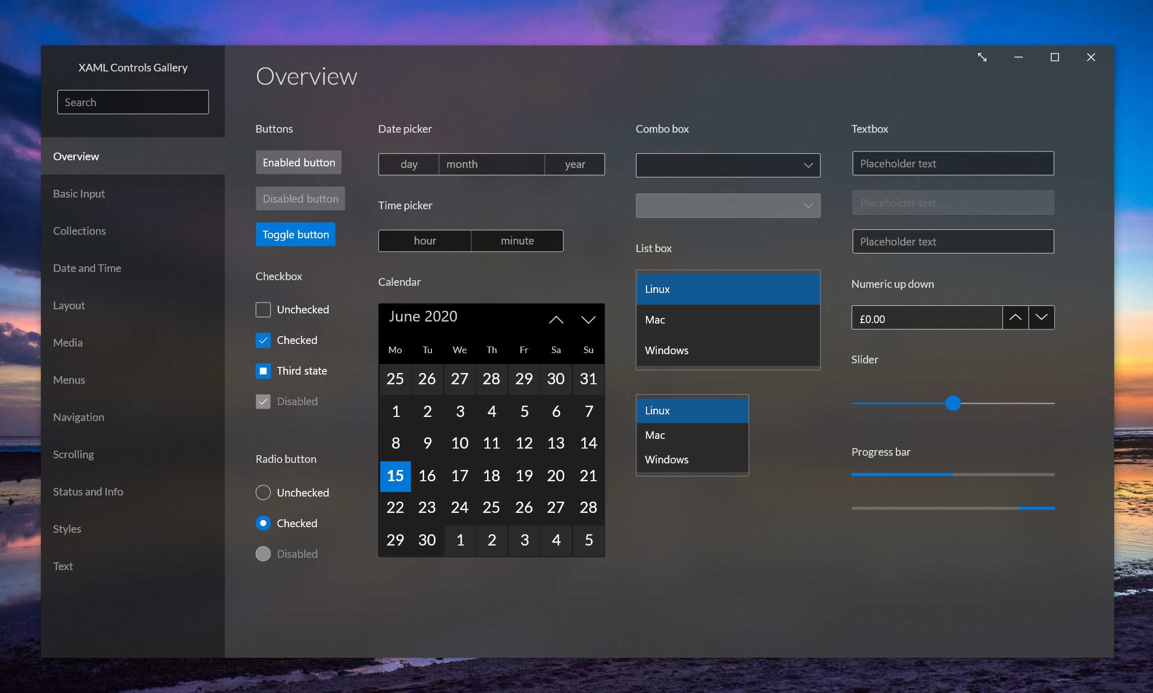
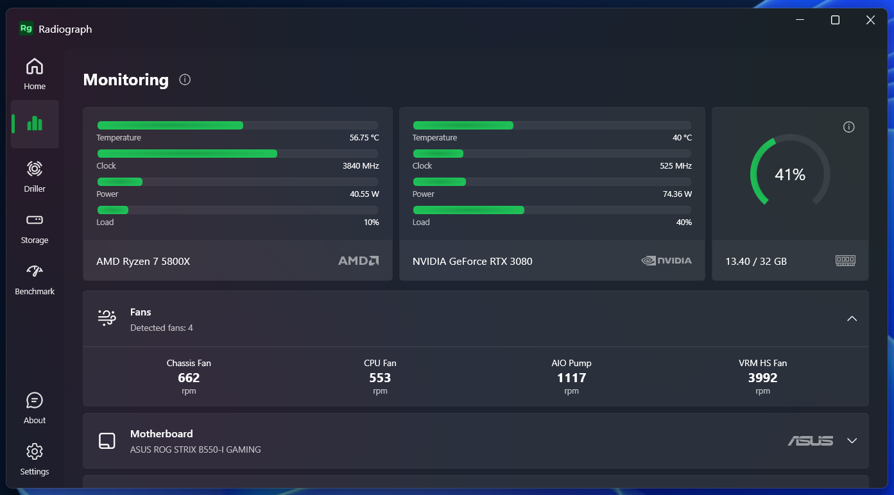
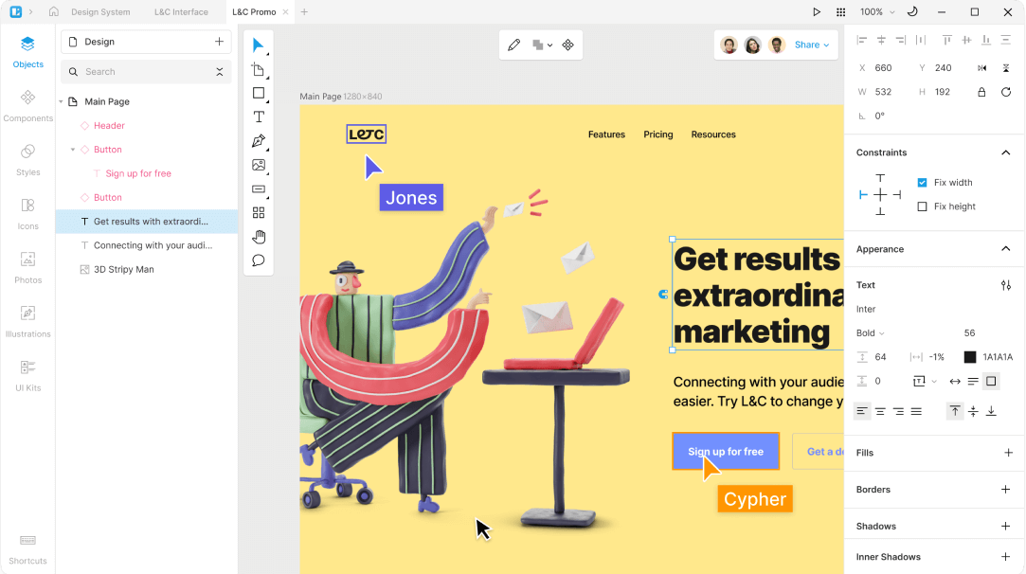
WPF vs. Avalonia

